Slide 1
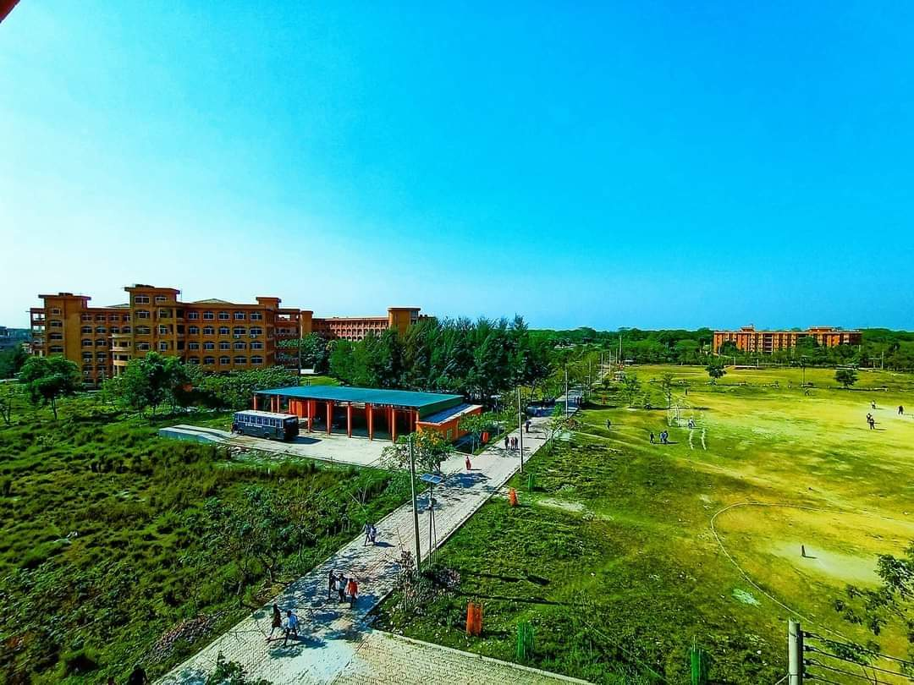
Welcome to My Presentation

Slide 2
Title:
University of Barishal

Slide 3
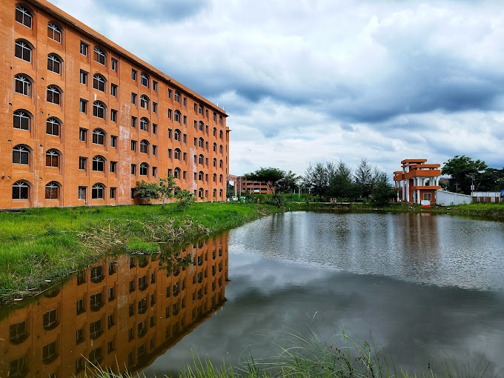
Brief Description
Address : Karnakathi, Barisal Sadar, Barisal-8254
Total area : 50 acres
Founded : 22 February 2011 .
Establishment Faculty : 4
Establishment Division : 6
Number of students admitted in the first batch : 400
Motto : (ÁvbB kw³) (Knowledge is power)
Chancellor : President Mohammed Shahabuddin
Vice-Chancellor : Dr. Mohammad Badruzzaman Bhuiyan (Routine-Charge).
Present Faculty : 6
Current Division : 25
Current Administrative Office : 23
Number Of Current Students : 9300
Current Number Of Teachers : 210
Part Time Teacher : 6
Number Of Present Officers : 121
Current Number Of Employees: : 152
Residential Hall : 4 (2 Male and 2 Female Halls)
Former Name: University of Barisal (2011-2018)

Slide 4

Brief Description
University of Barishal (Bengali: বরিশাল বিশ্ববিদ্যালয়, Boriśhāl Biśbôbidyālôẏ; also known as Barishal University or simply BU) is a public university located in Barishal, a divisional city in southern Bangladesh.[3] It is the country's 33rd public university.
The university was established in 2011 and began academic activities at undergraduate level in six departments under four faculties on 24 January 2012. The university offers degrees at undergraduate and postgraduate levels. The university houses 25 academic departments under six faculties, where eighteen departments are currently providing postgraduate degrees. Every year almost 1,400 students are admitted to undergraduate programs in the university. The university started its academic activities at the temporary campus at Barishal Zilla School and then shifted to its permanent campus. The permanent suburban campus of 50 acres of the university is located in Barisal Sadar Upazila beside Dhaka-Patuakhali Highway on the bank of Kirtankhola river.

Slide 5
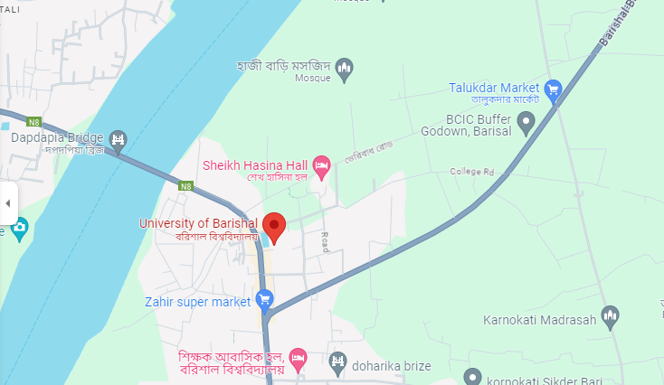
Location
University of Barishal is situated in the district of Barishal under Barishal Division. It is located at Karnakathi on the eastern bank of the Kirtonkhola river beside the Barishal-Patuakhali highway about 2 kilometers from the center of Barishal City. The university campus is spread over 50 acres of land.

Slide 6
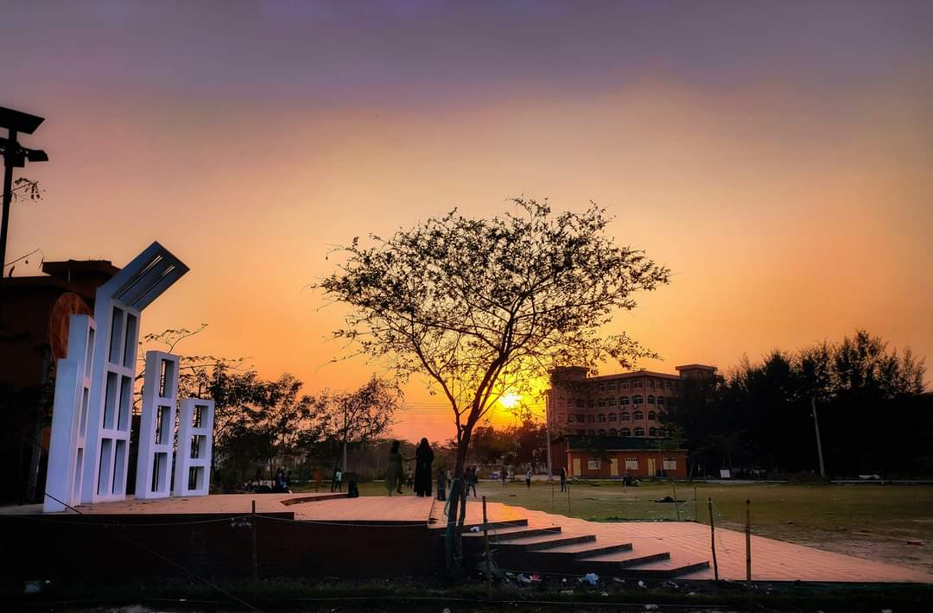
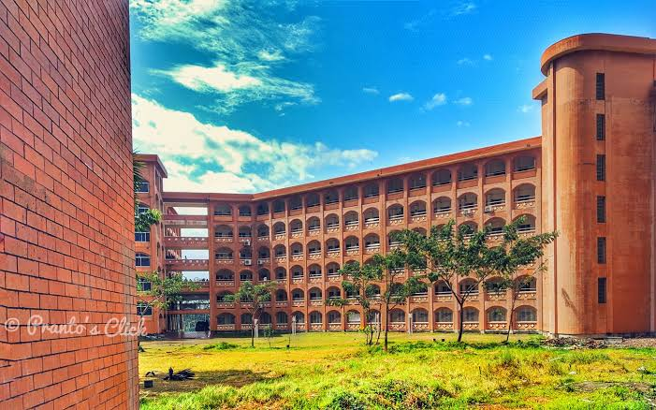
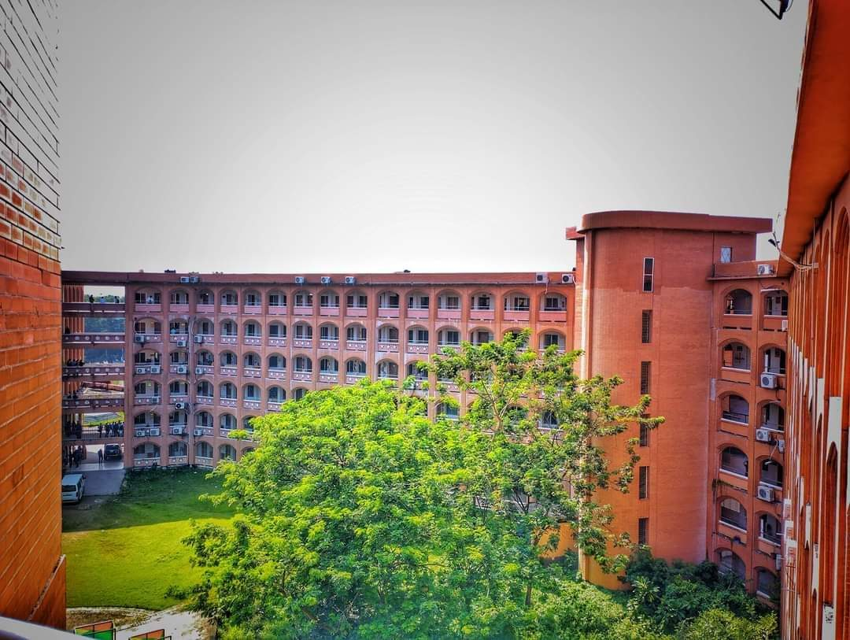
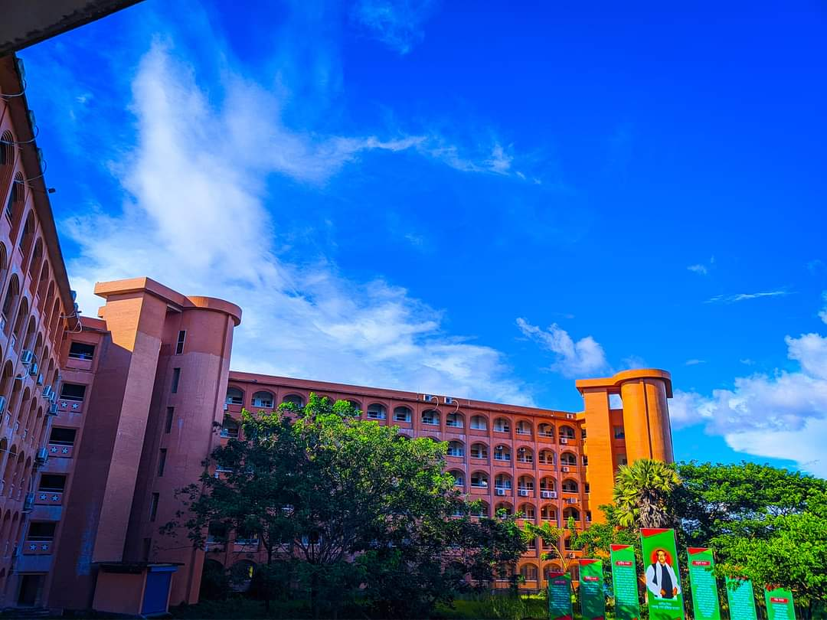
Campus
The university campus covers an area of 50 acres, and is landscaped around the Kirtankhola river with field areas and plants making the campus a natural arboretum. Facilities include academic buildings, administration building, auditorium, library, computer centre, workshop, research laboratories, halls of residence, teachers' quarter, mosque etc. The university has inside its boundaries a bank, a canteen and a large auditorium.
Campus

Slide 7
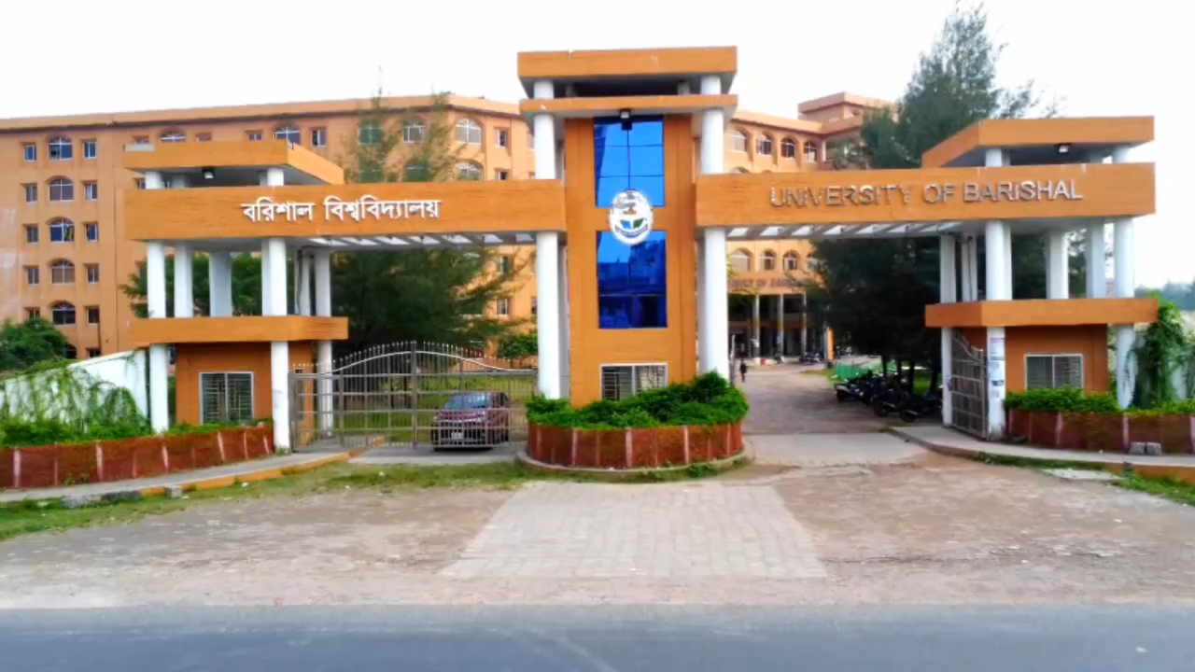
The Beauty of BU Campus

Slide 8
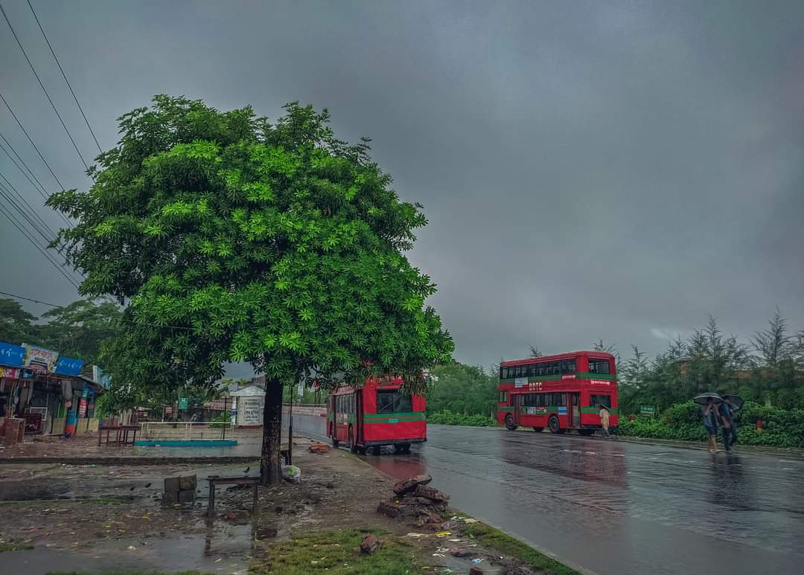
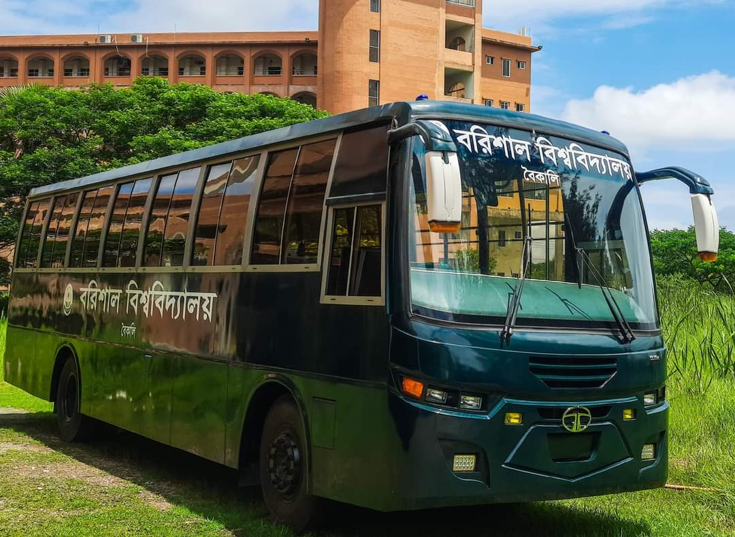
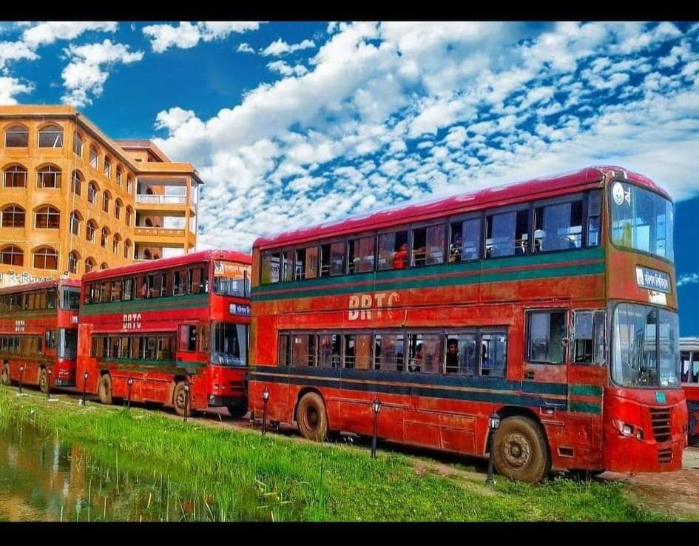
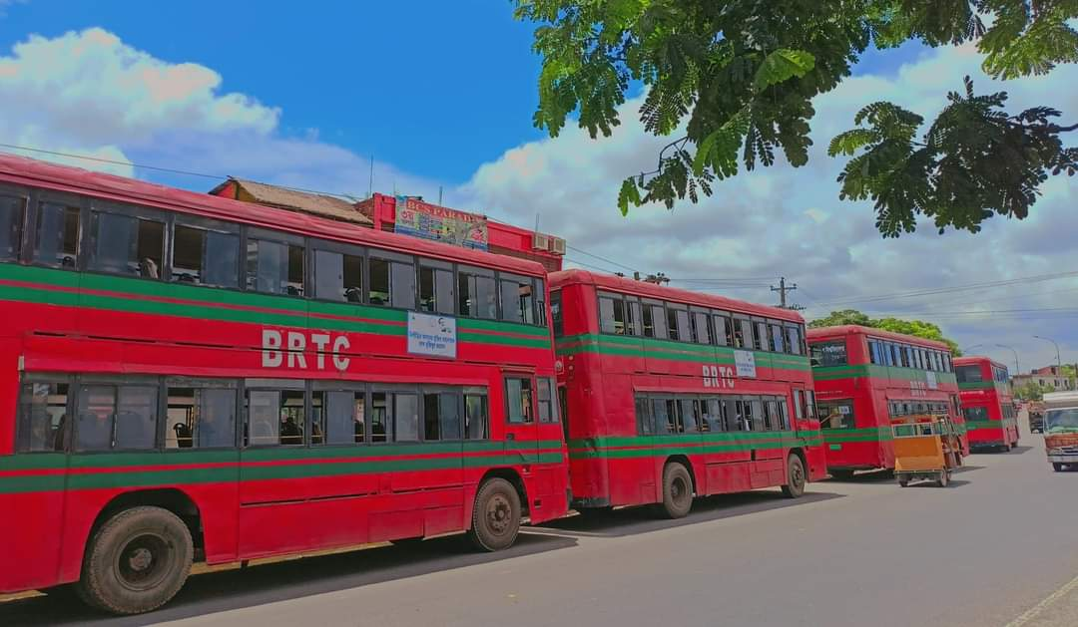
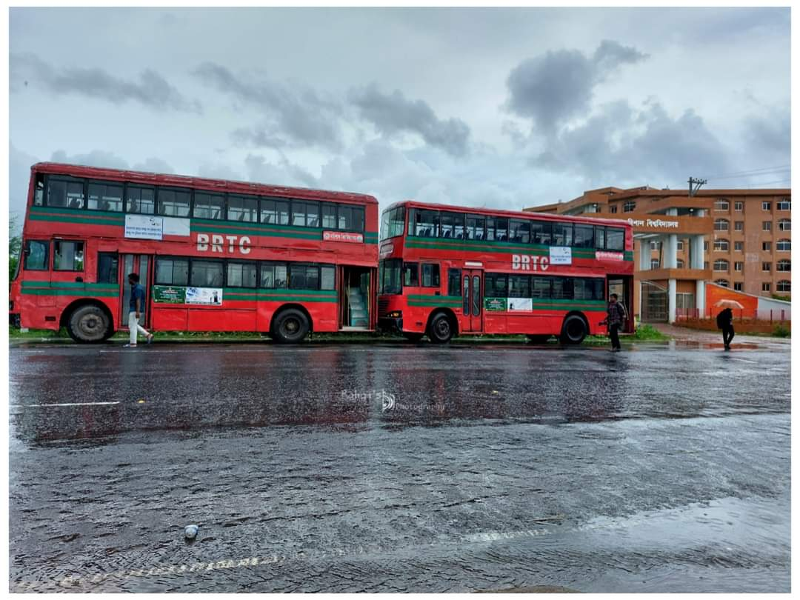
Transportation
The university runs its own regular bus service to and from the city to facilitate frequent commuting of the students residing there. Friday and Saturday are weekly holidays. The university own single and doubled-decker buses as well as microbuses to facilitate transport of students, staff and faculty members.
Transportation

Slide 9
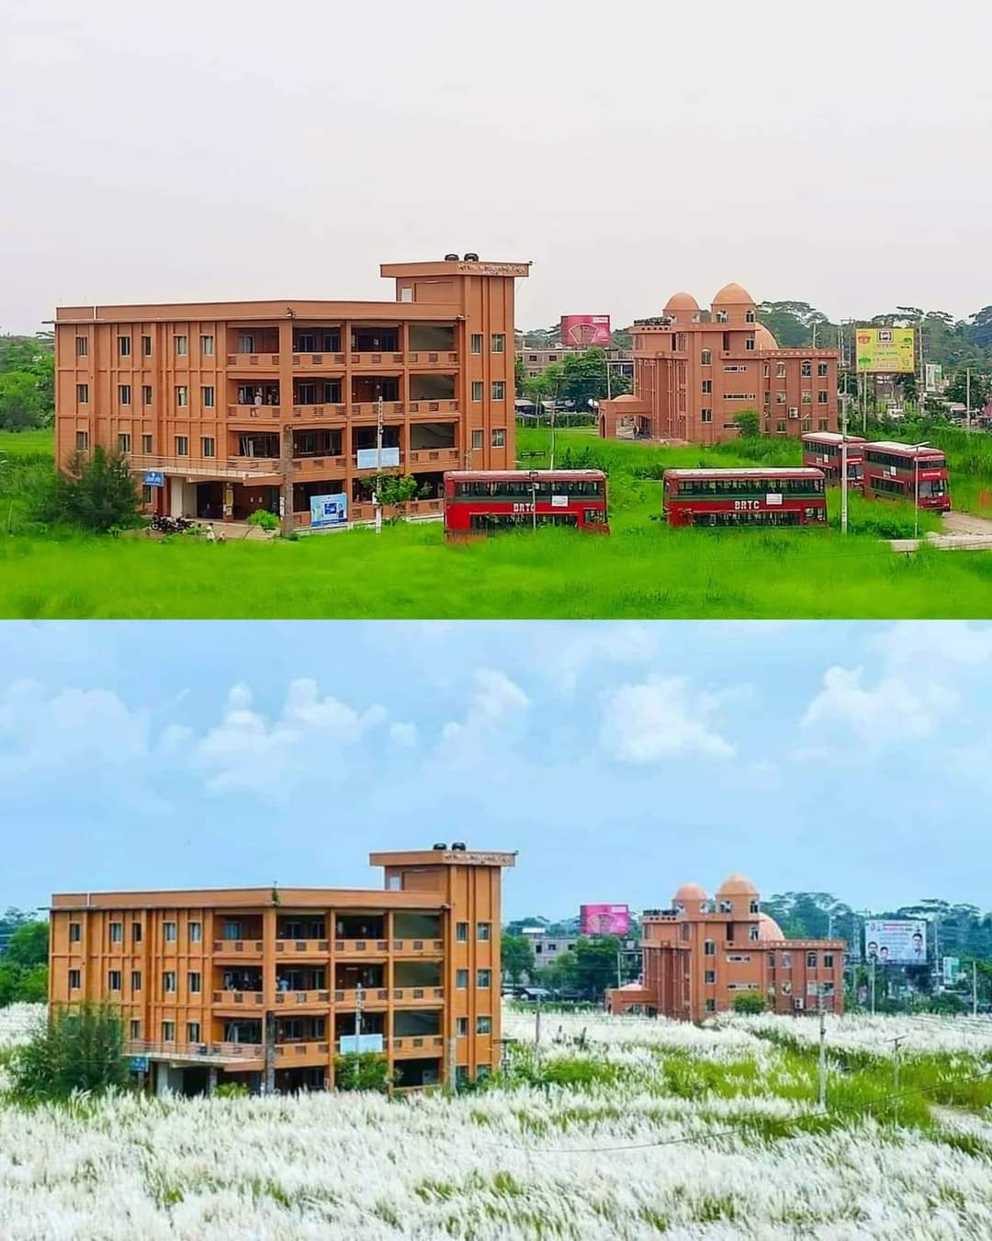
Medical Center
The University Medical Center is equipped for primary care but serious cases are referred to a Medical college hospital (Sher -E -Bangla Medical College Hospital) which is about 4 kilometres away.
Medical Center

Slide 10
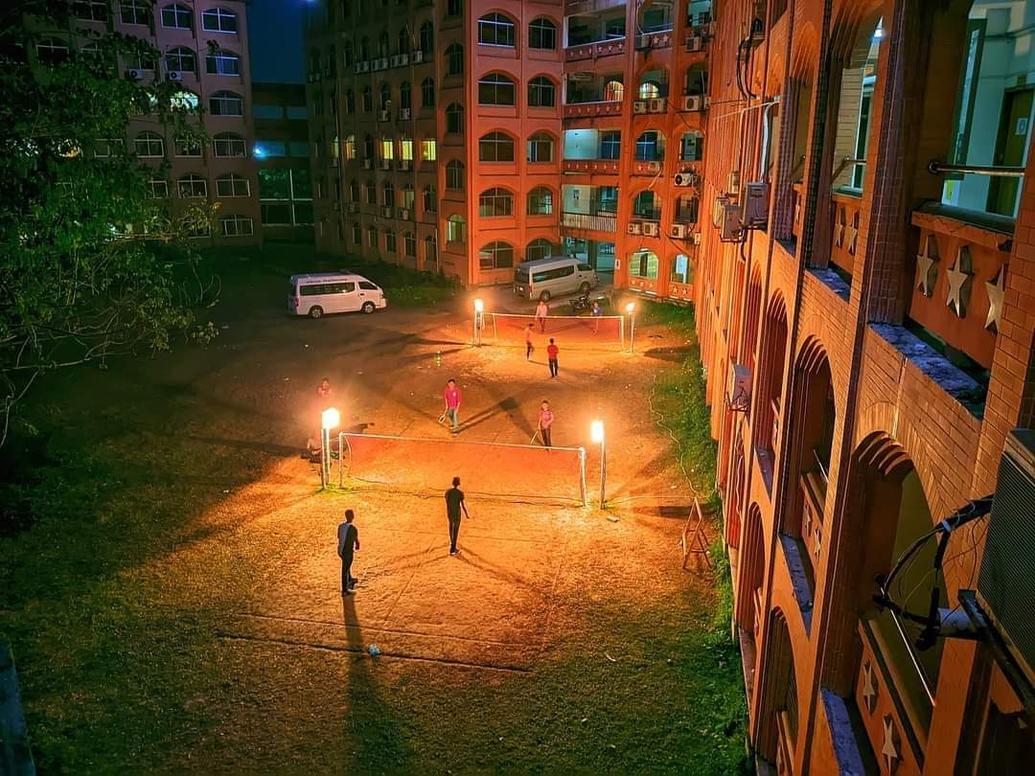
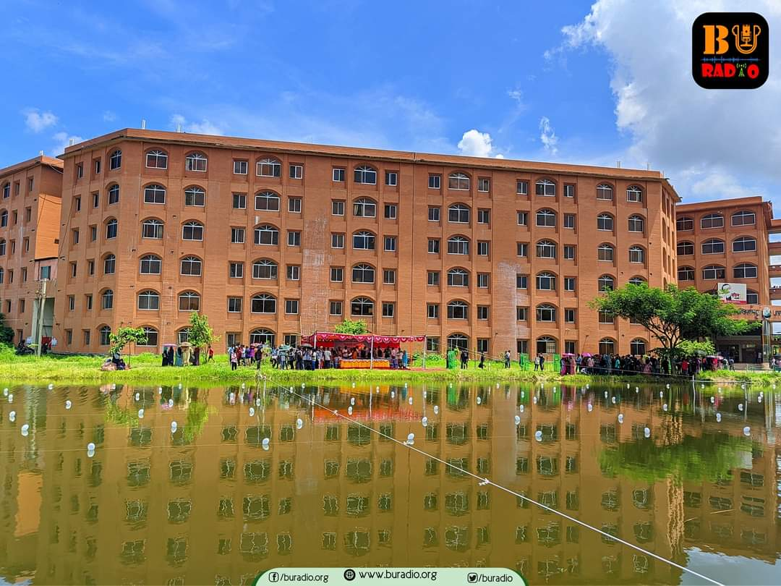
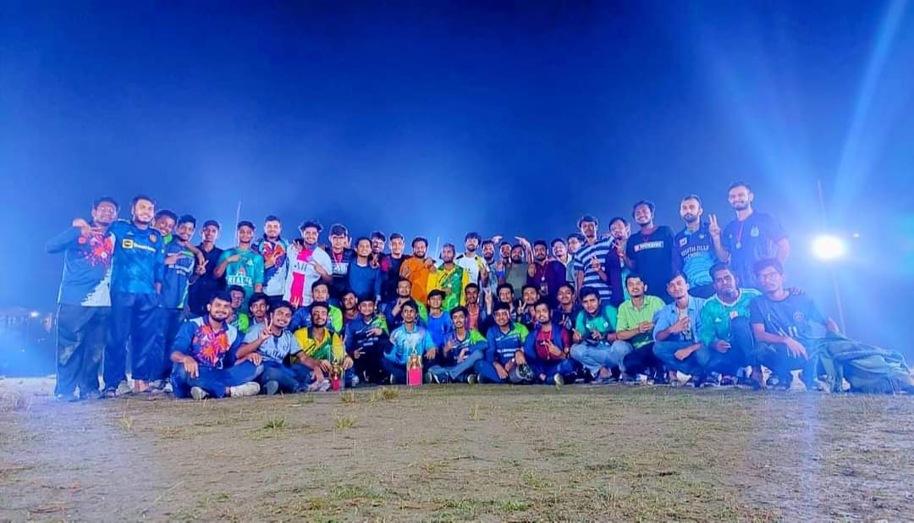
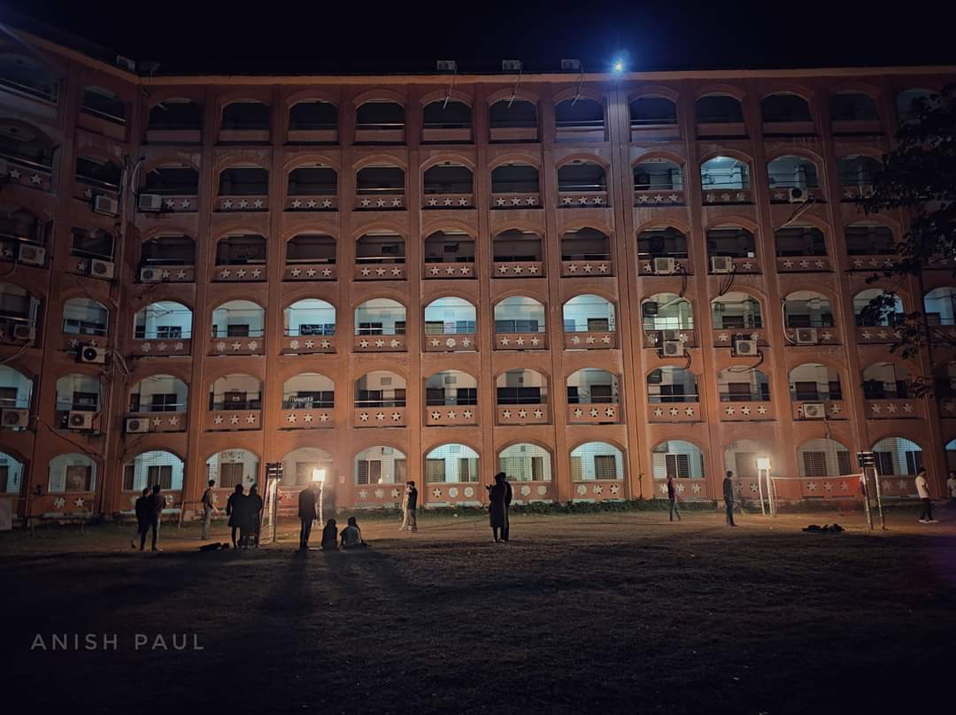
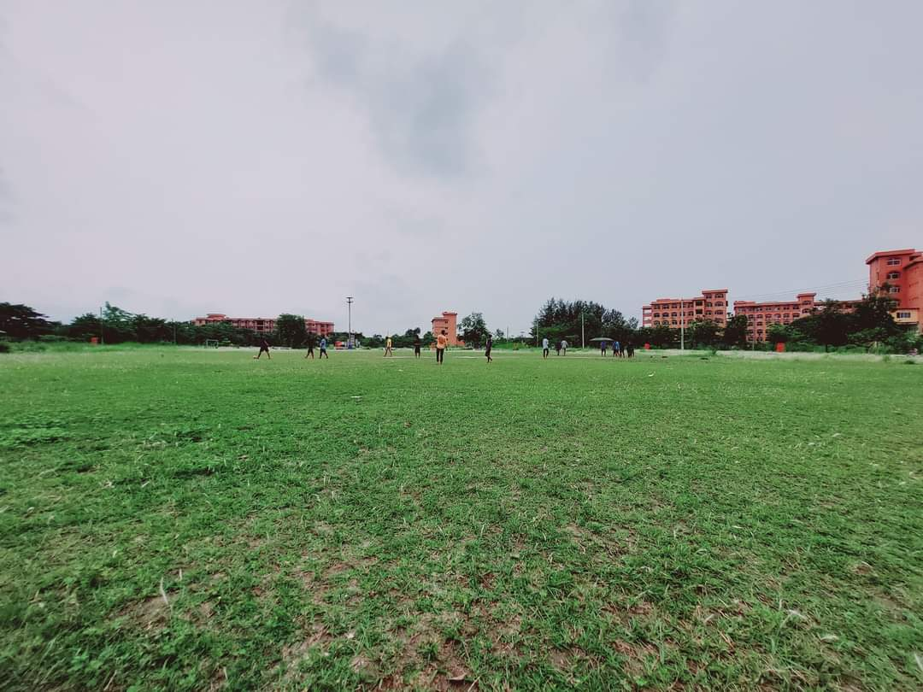
Sports and entertainment
The university provides facilities for football, cricket, volleyball, table tennis etc. The students play tennis, badminton and other games as well. The students arrange debate, cultural show etc. The annual sports events are arranged at University Playground.
Sports

Slide 11
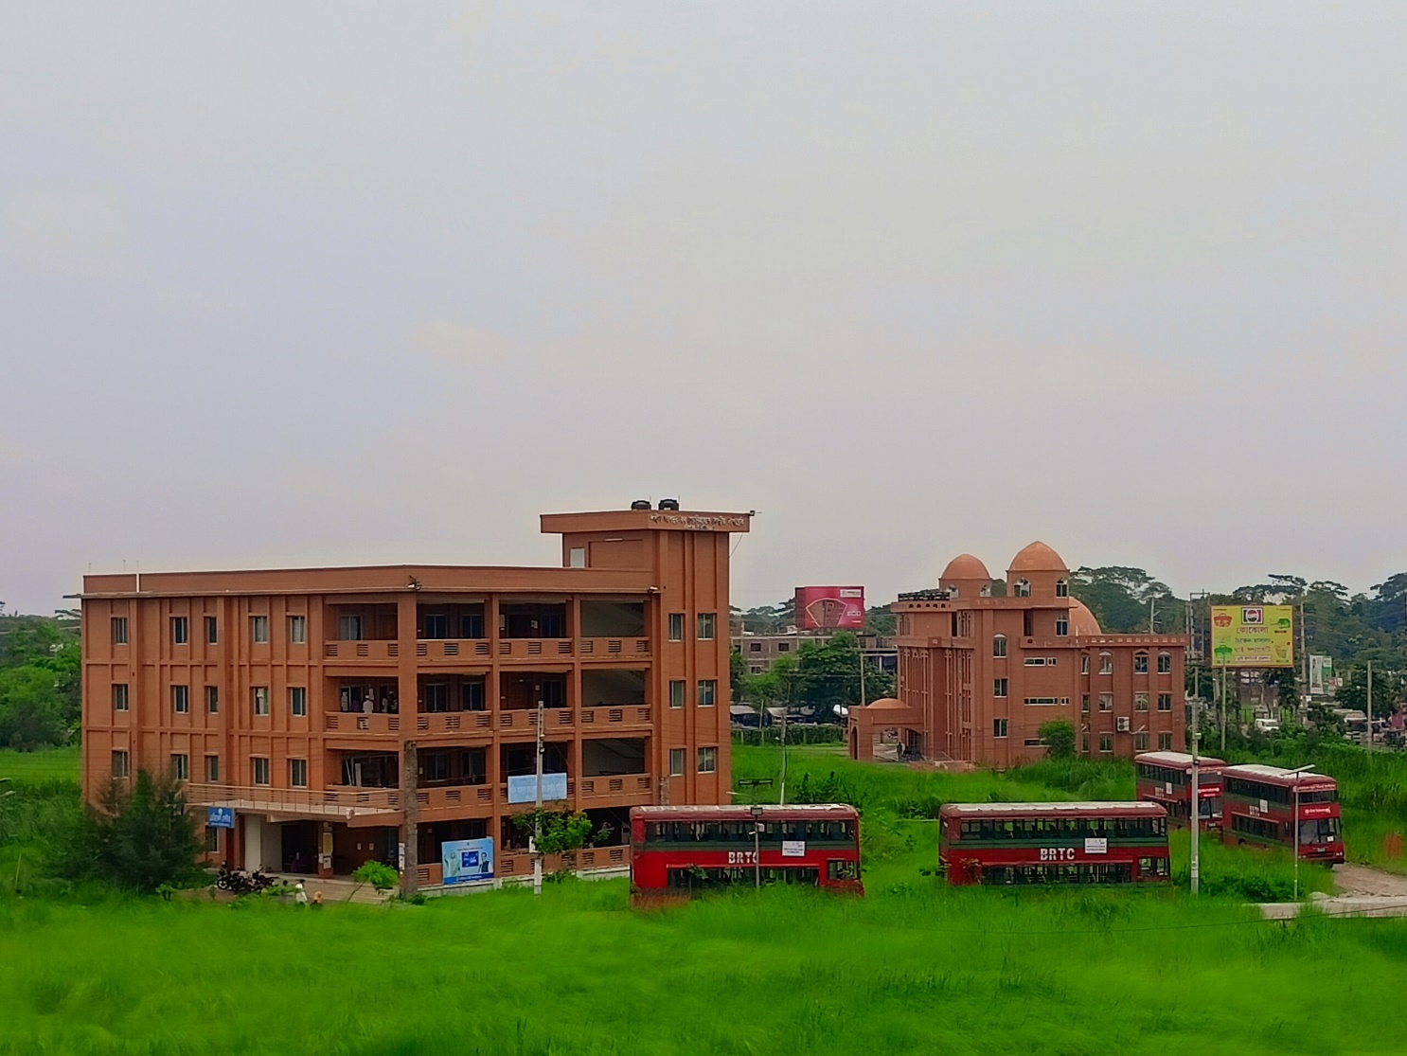
Library
The library has more than 20,000 books and hundreds of journals and periodicals in its collection. Approximately 150 students can use these facilities at a time.

Slide 12
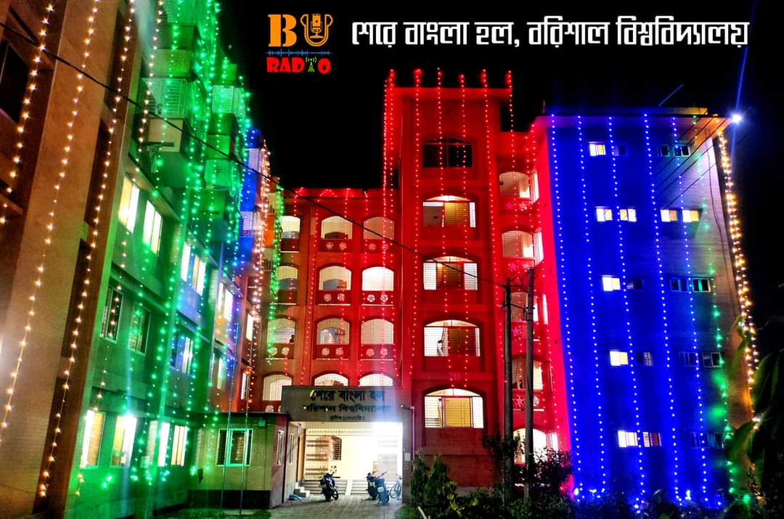
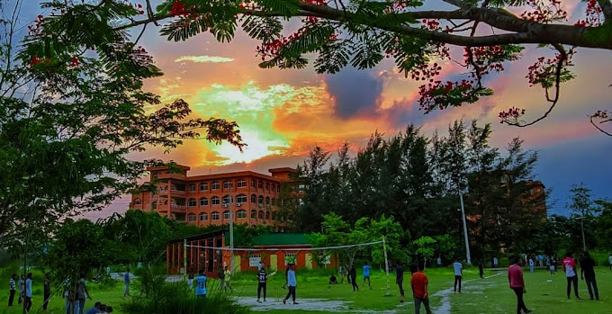
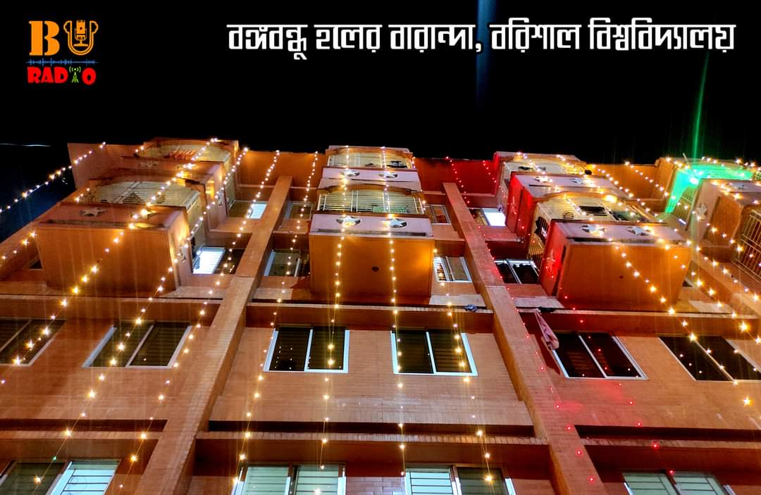
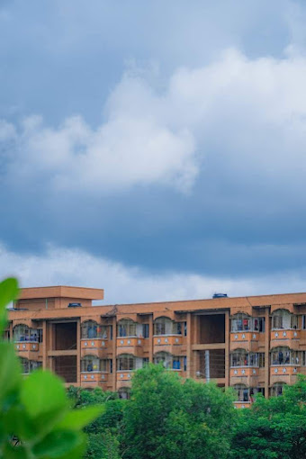
Halls of Residence
There are four dormitories for students
Boy's halls
Girl's halls
Name | Established | Number of accommodations | Note
Bangabandhu Hall | 2011 | 500 | Sheikh Mujibur Rahman
Sher E Bangla Hall | 2011 | 500 | A. K. Fazlul Huq
Name | Established | Number of accommodations | Note
Sheikh Hasina Hall | 2011 | 500 | Sheikh Hasina
Sheikh Fazilatunnesa Mujib Hall | 2023 | 500 | Sheikh Fazilatunnesa Mujib

Slide 13
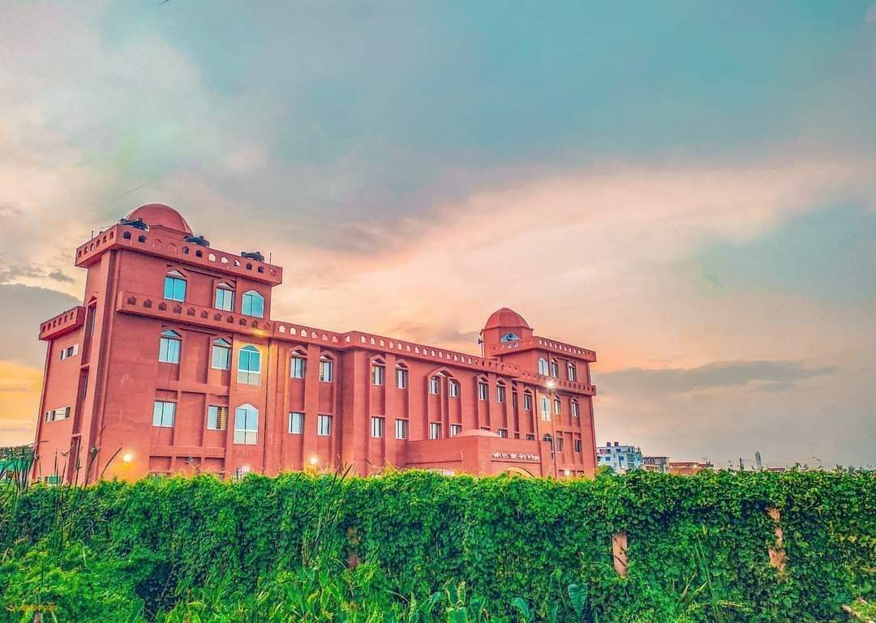
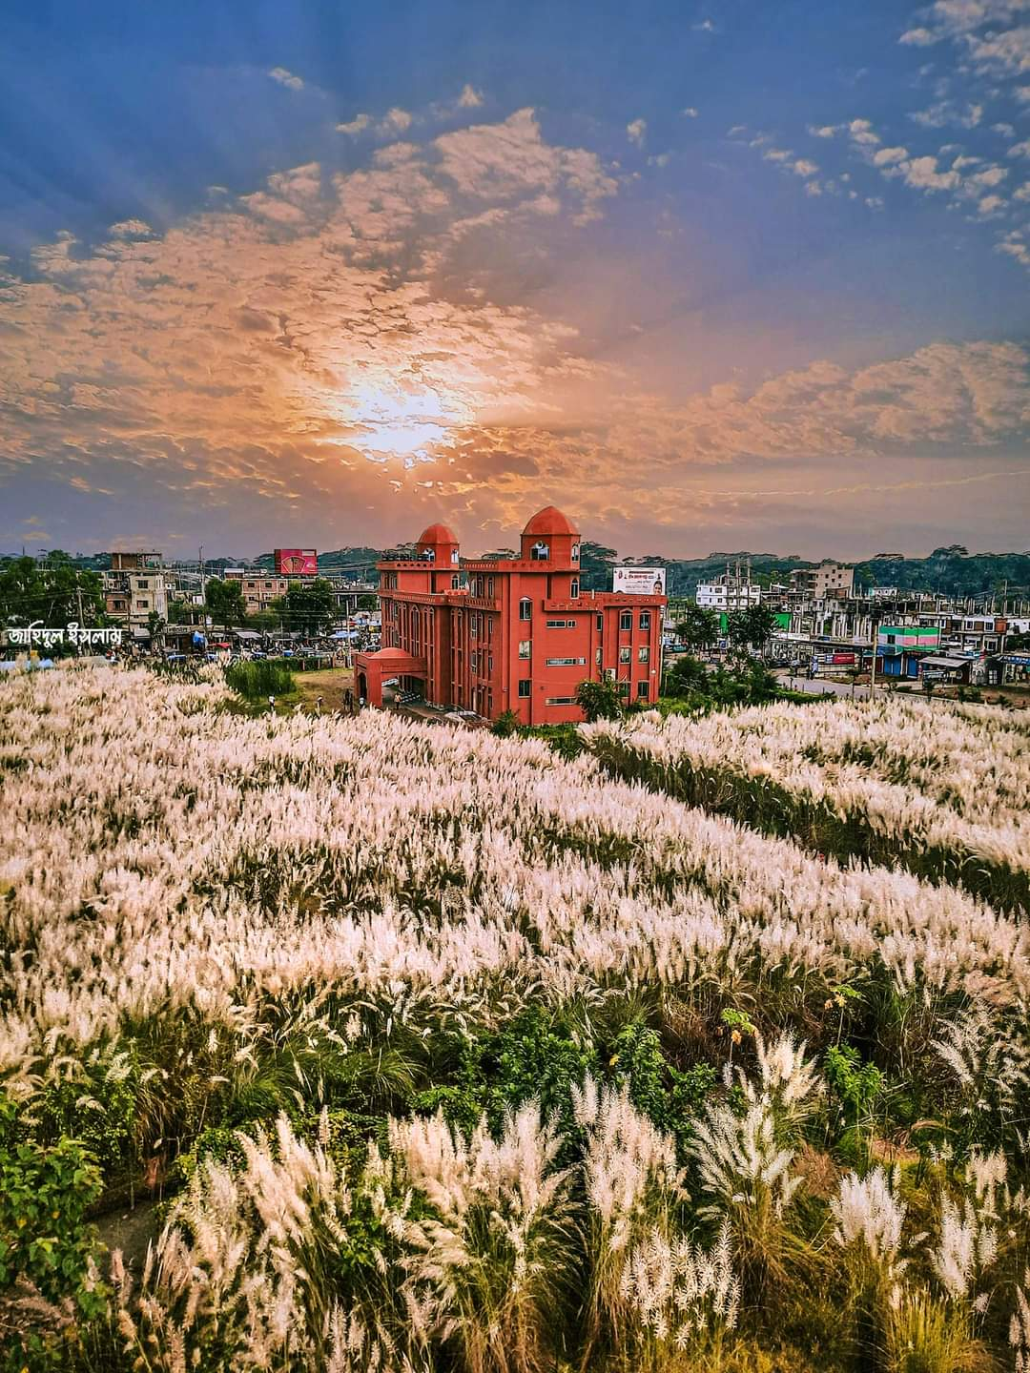
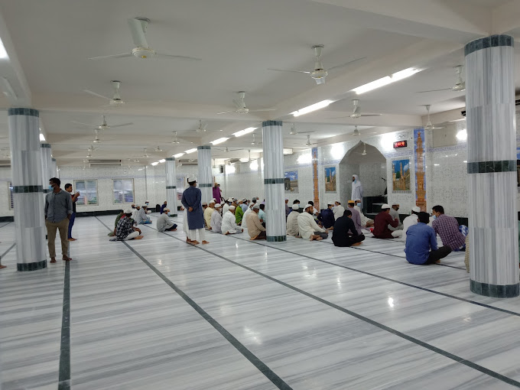
Mosque
Barisal University has a central mosque

Slide 14
Reference :
https://bu.ac.bd/
https://en.wikipedia.org/wiki/University_of_Barishal
https://www.google.com/

Slide 15
Thank You

